Slide 1

Testing
Work Done till mid March
- Apoorv Gupta

Slide 2
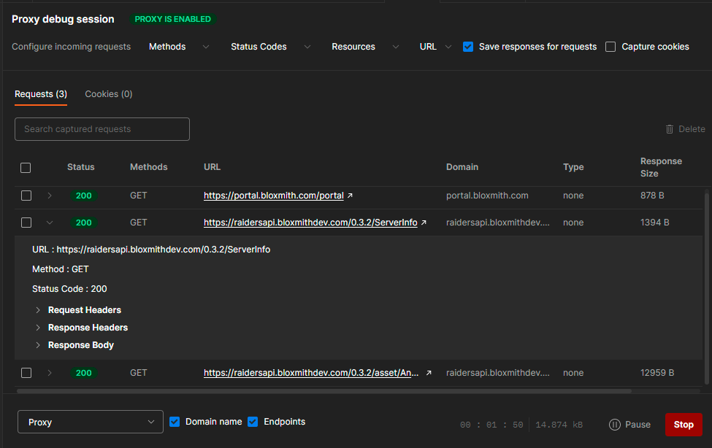
Capturing HTTPS Request in Postman -
Install CA certificate, to capture HTTPS request through proxy server.
Create ‘network_security_config.xml’ file in ‘AndroidManifest.xml’.
It will capture HTTPS request and create collection in postman with headers, params and body data.

Slide 3
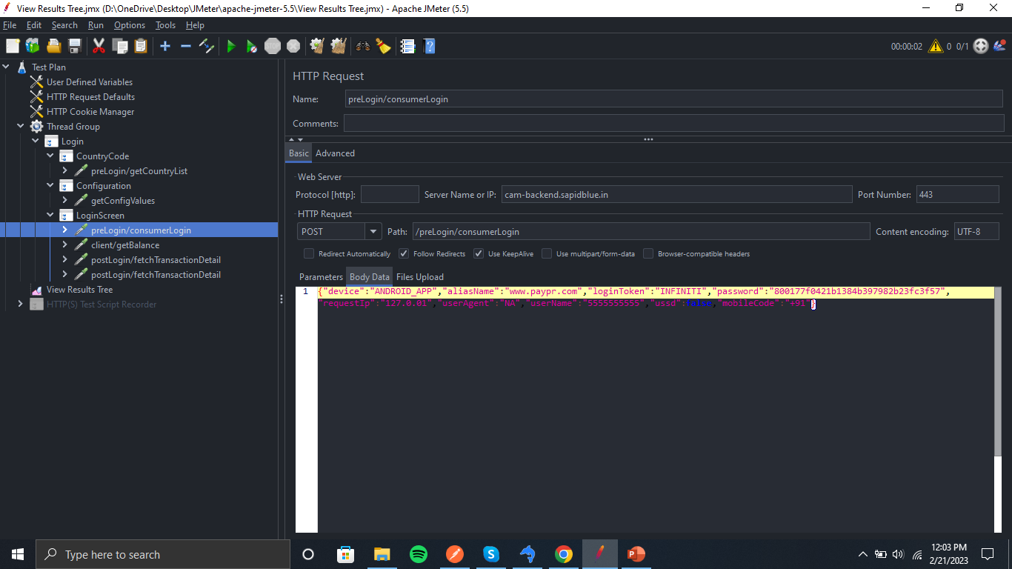
Capturing HTTPS Request in JMeter -
First install CA certificate in mobile/windows.
Configure port then set up proxy settings in devices.
By using app, it will record all the APIs hit by the users and it will group it in same functionality folder, like signup, Login, etc.
This is to be done to save time for create collection of APIs and to do performance testing.
Throttling settings can also be done.

Slide 4
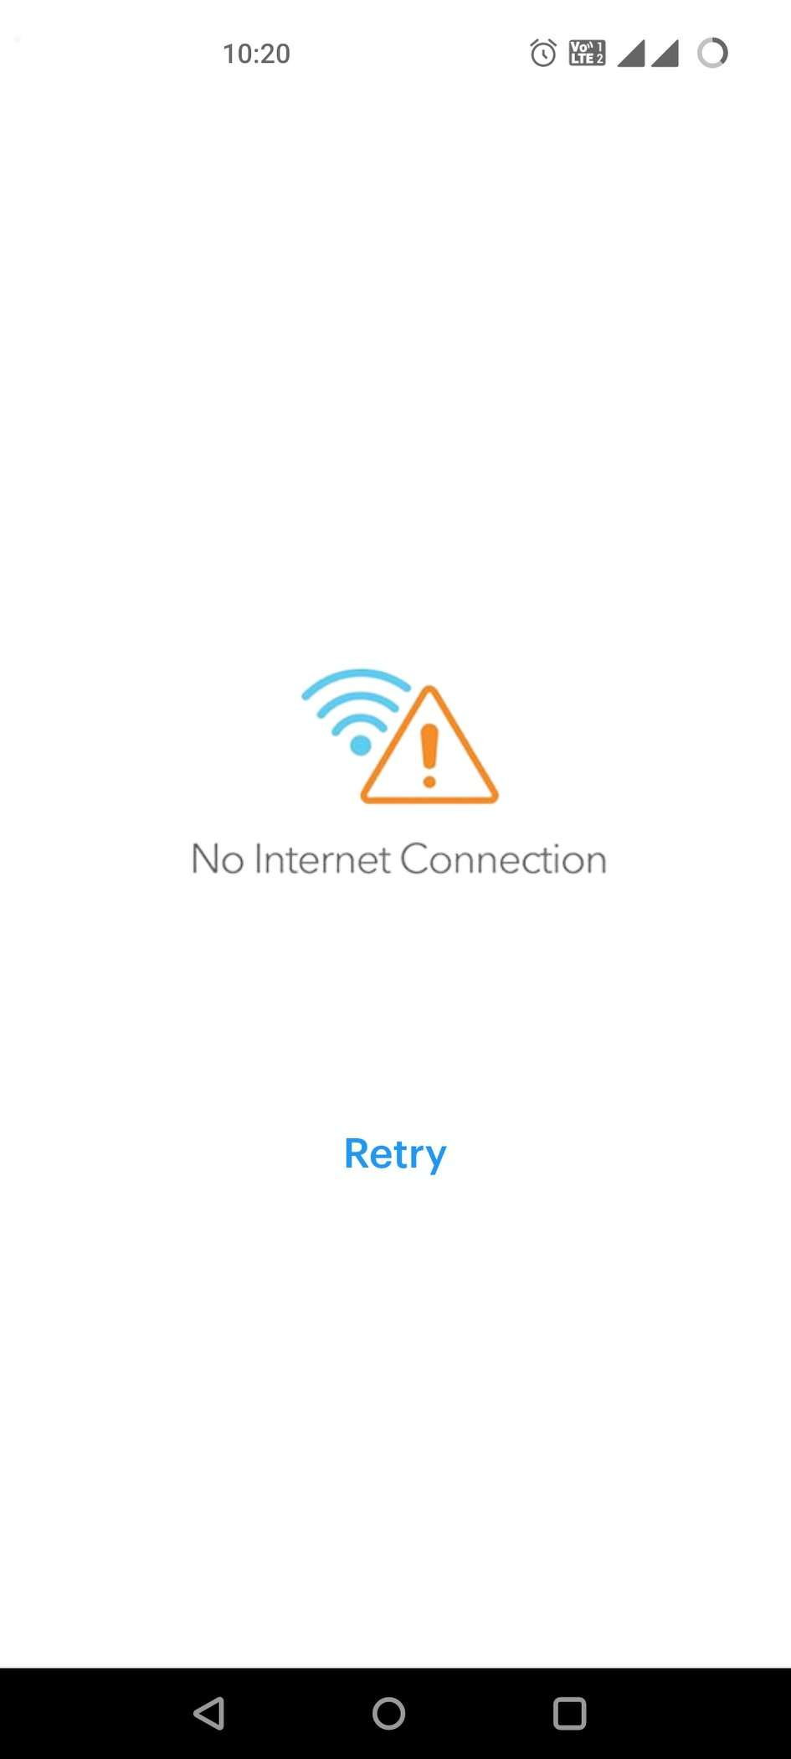
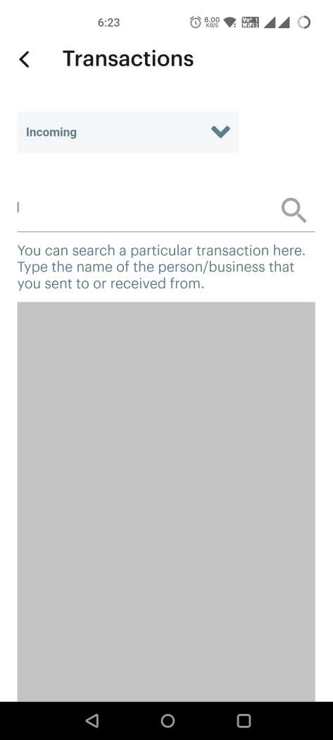
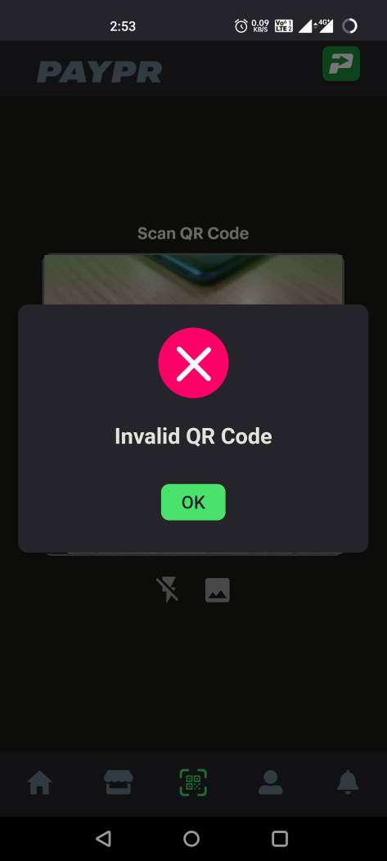
Mobile App Testing -
Search functionality not working after doing pagination.
Invalid QR code bug
‘No Internet connection’ bug.
Location Permission bug
QR Scanner torch bug
Dynamic Link error

Slide 5
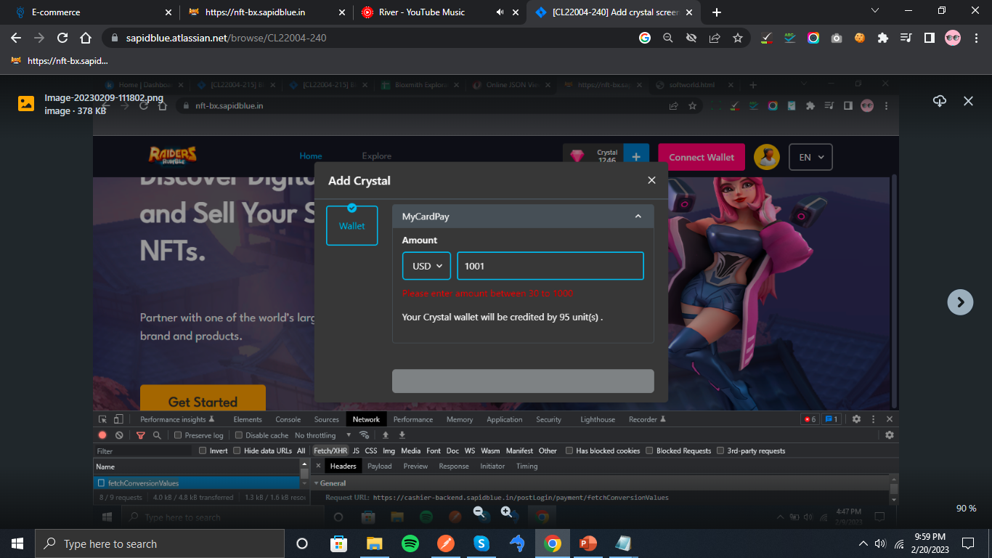
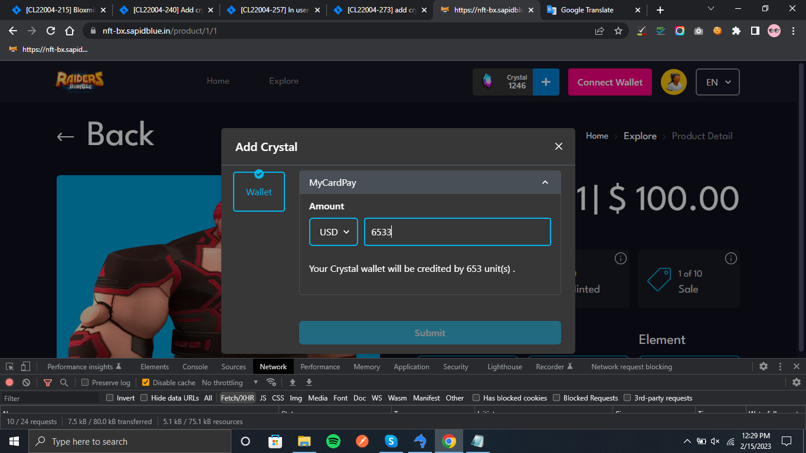
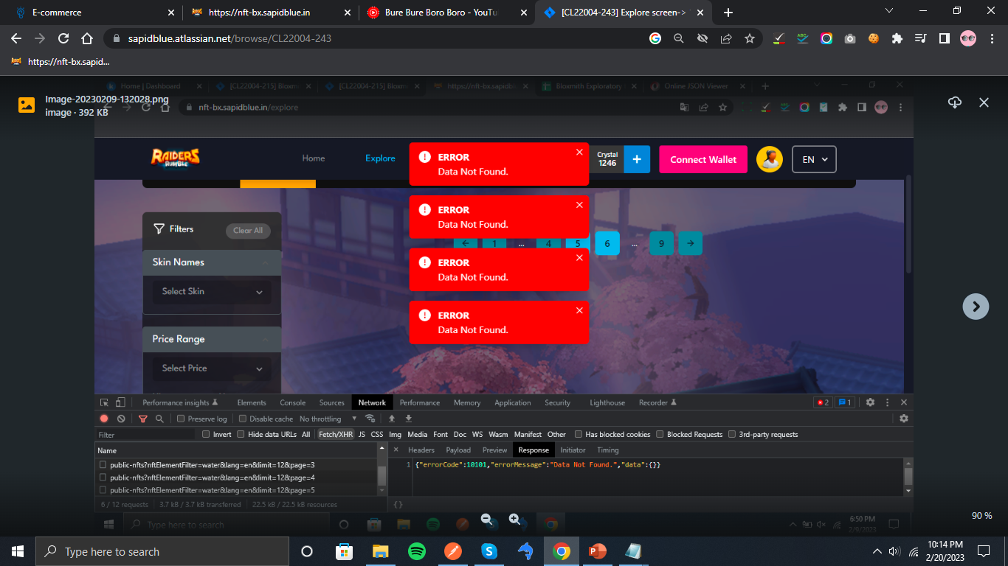
NFT Portal Testing -
Error message should also be in specific language chosen.
Add a pre-loader on every screen.
Sign in with google screen display bug.
(Throttling)
Also did some API testing.

Slide 6
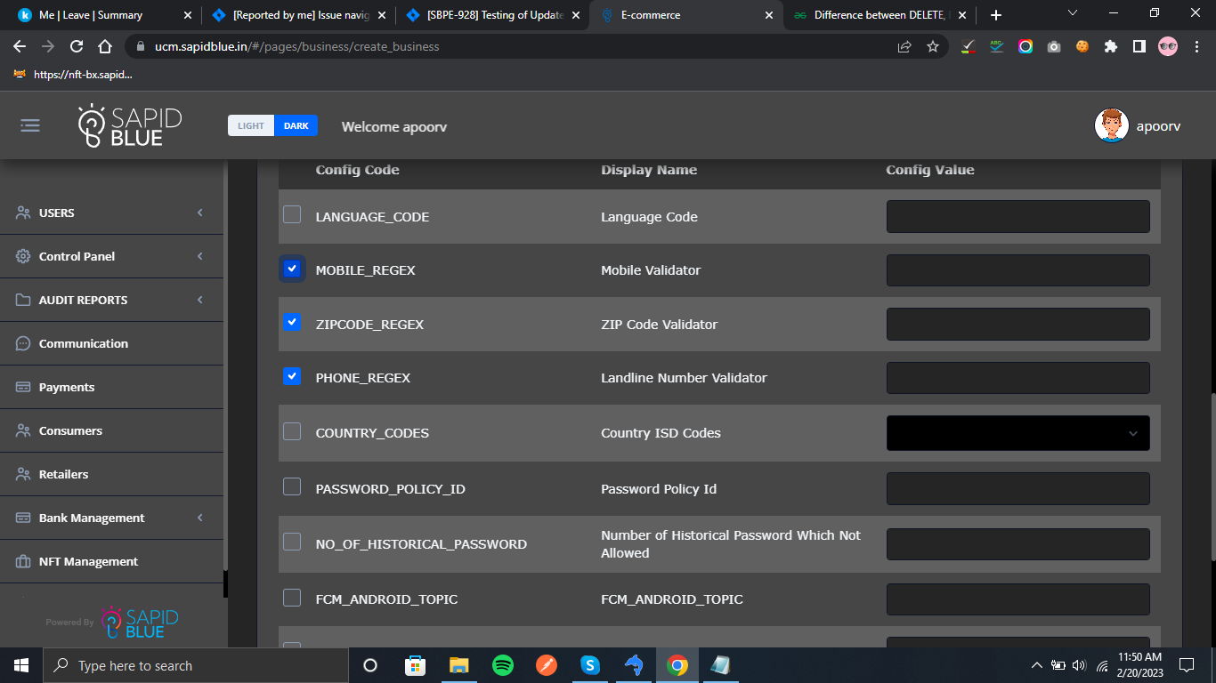
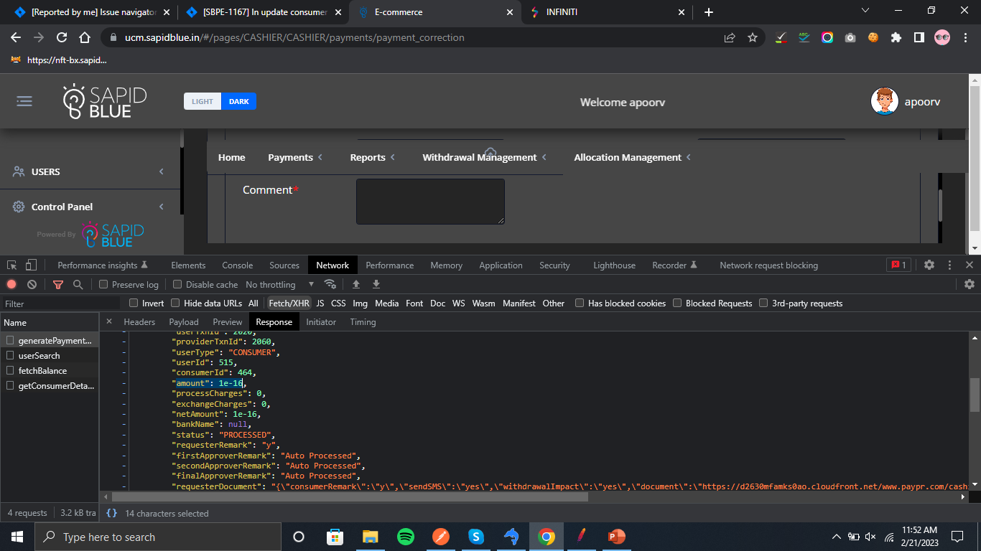
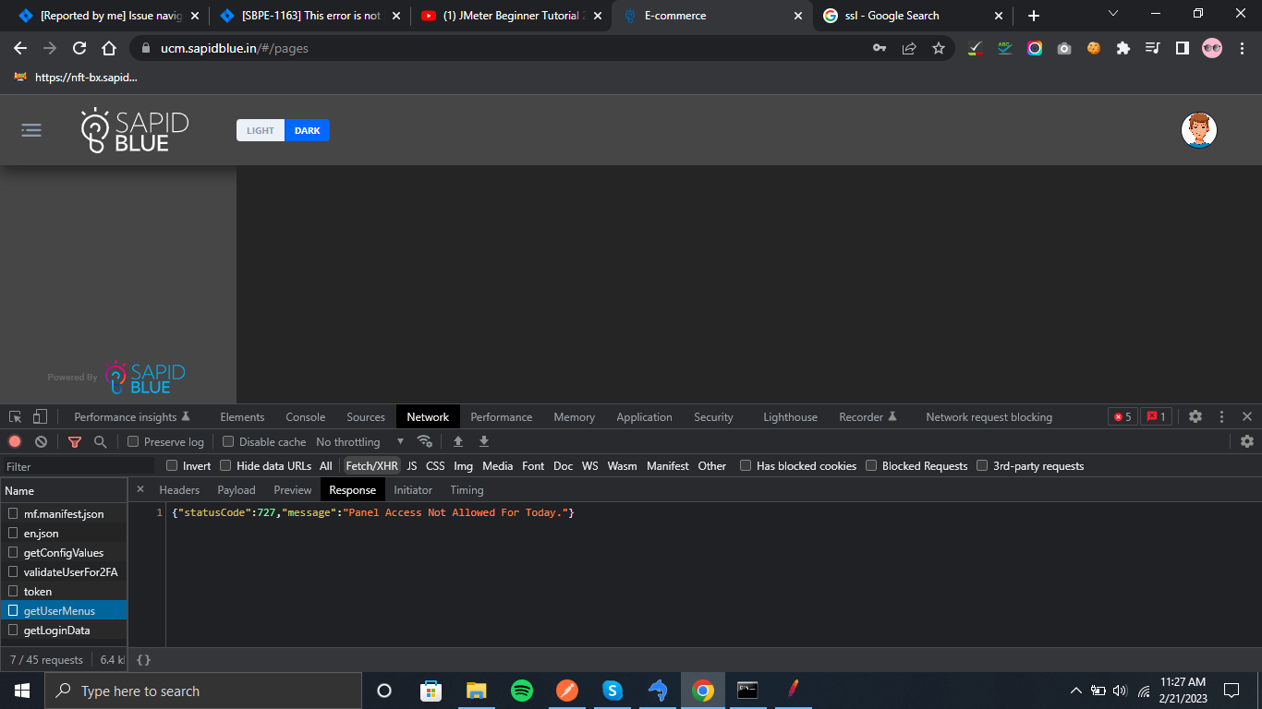
UCM Backoffice Testing -

Slide 7
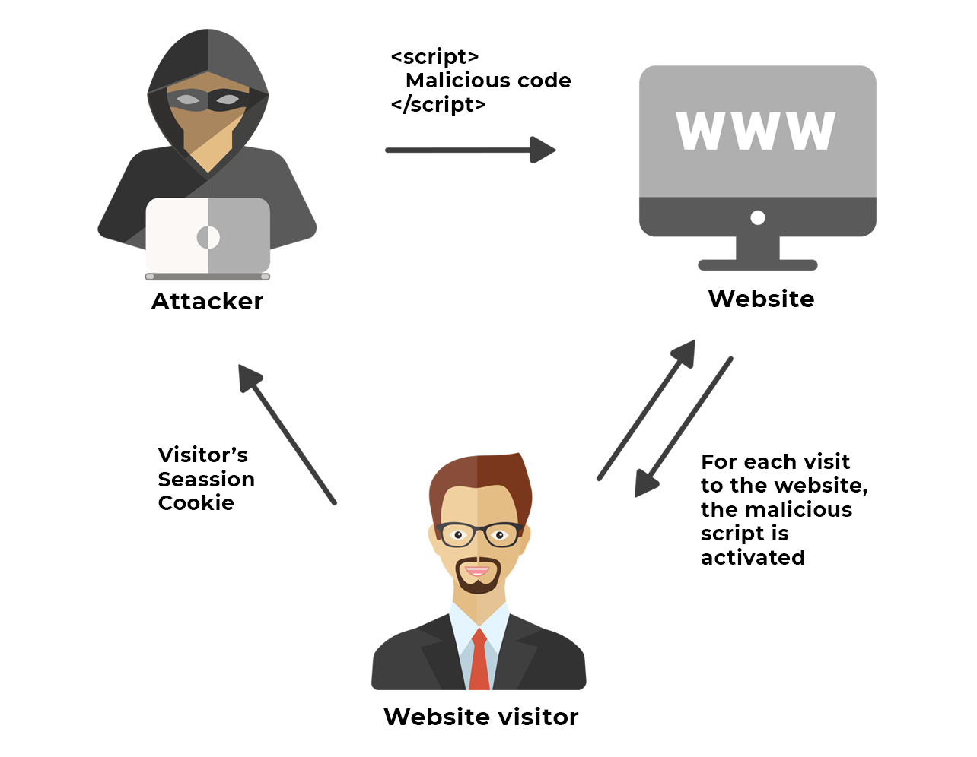
Basics Of Security Testing -
URL Manipulation
SQL INJECTION
Cookie Based Testing
Cross-site Scripting (XSS)
Brute Force Attack
Session Expiry

Slide 8
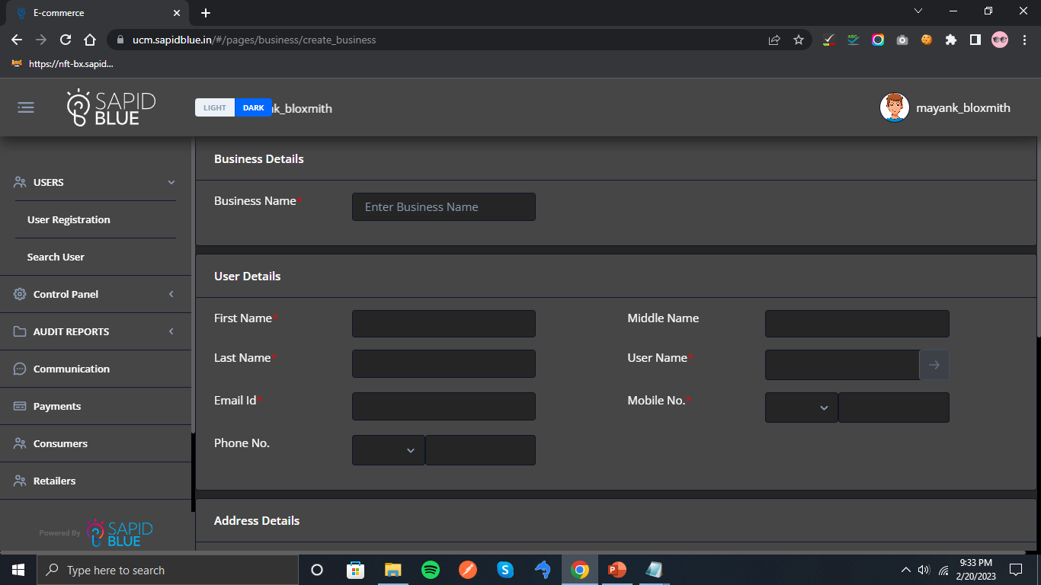
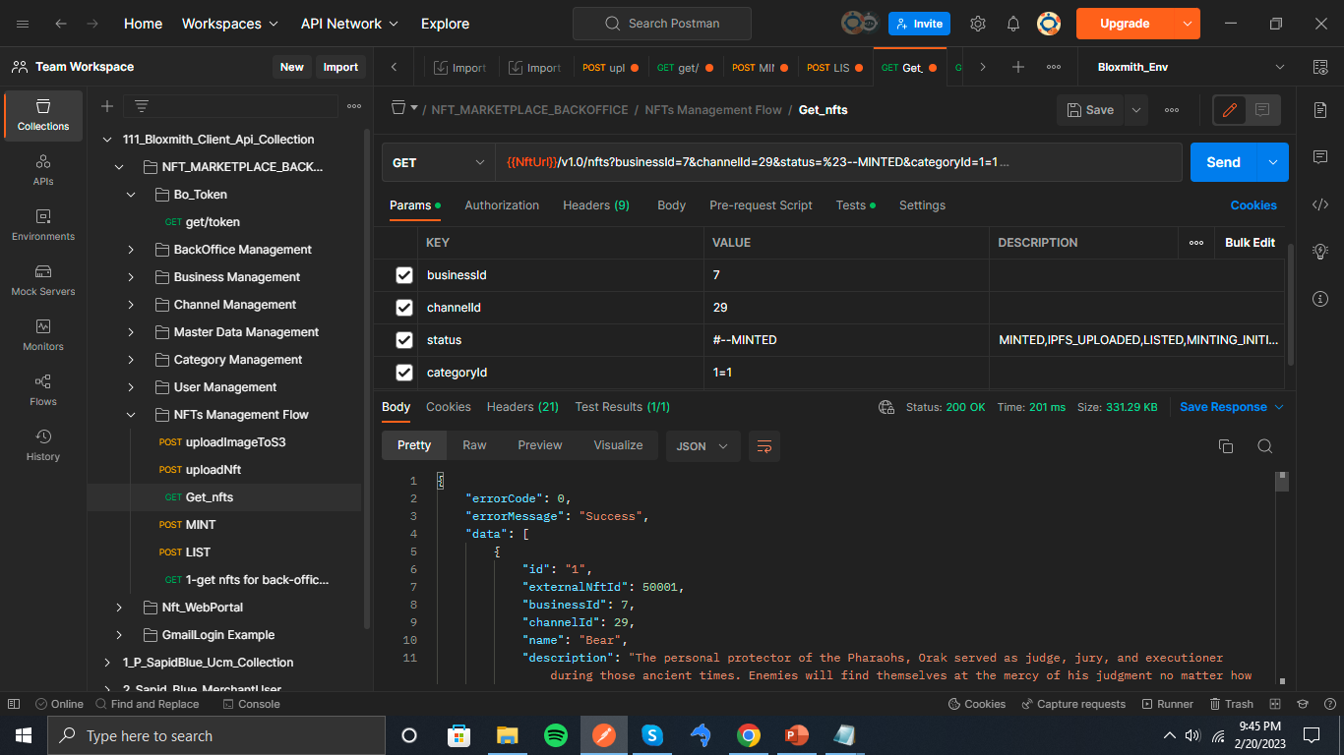
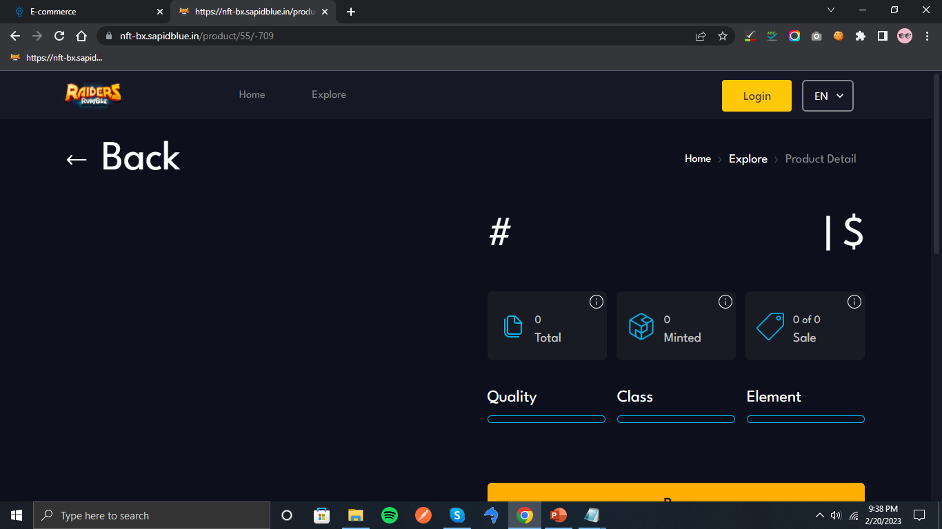

Slide 9
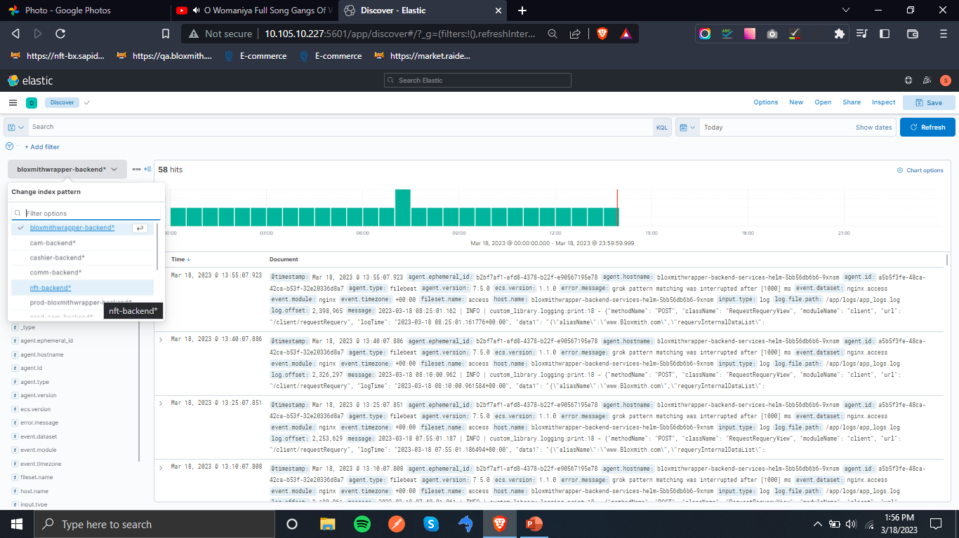
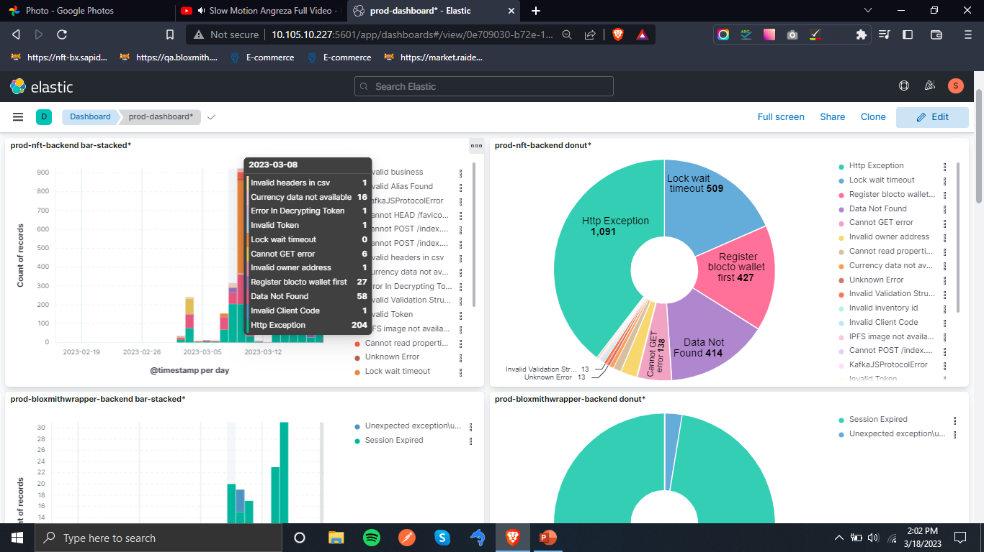
ELK Data Views and Kibana dashboard

Slide 10
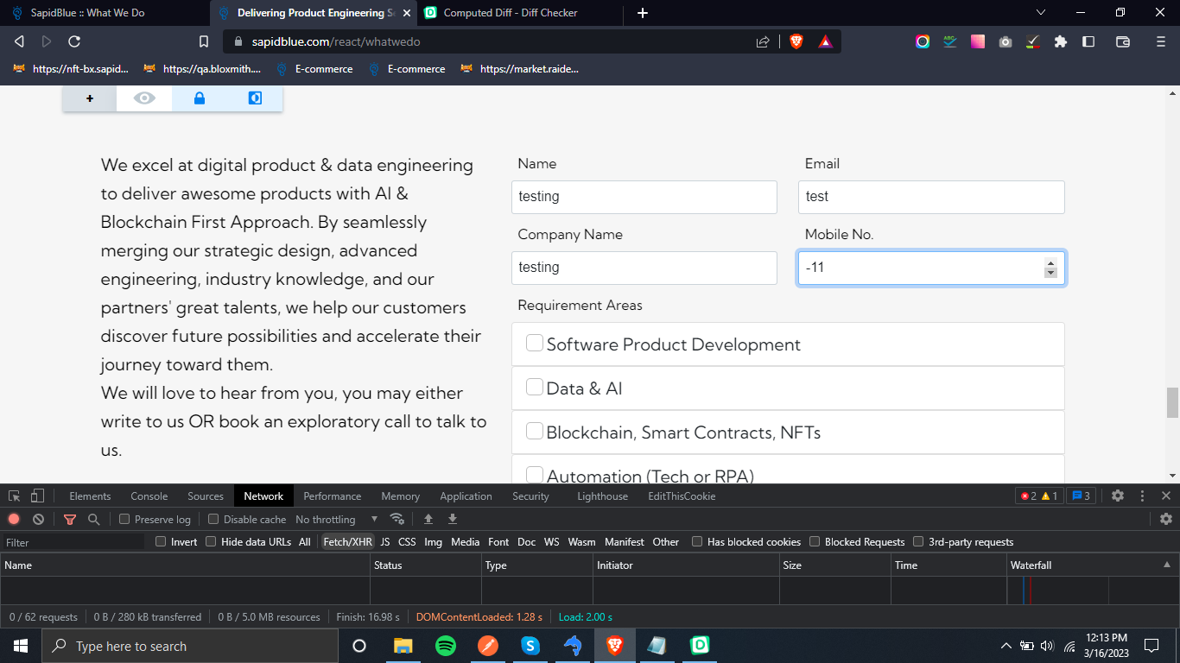
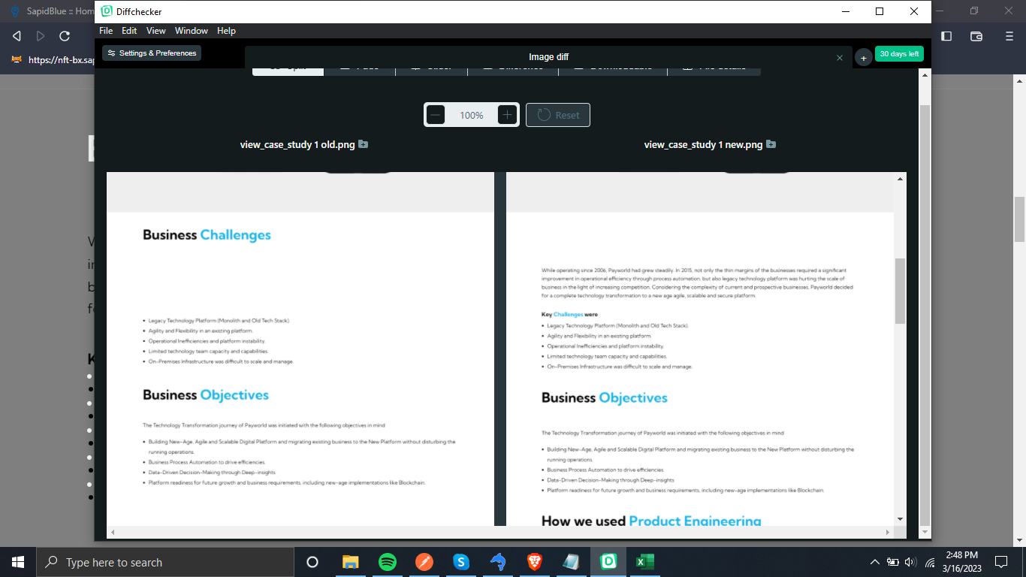
SapidBlue Website Verification

Slide 11
THANK YOU

Slide 12
Testing
Work Done till mid December
- Apoorv Gupta

Slide 13
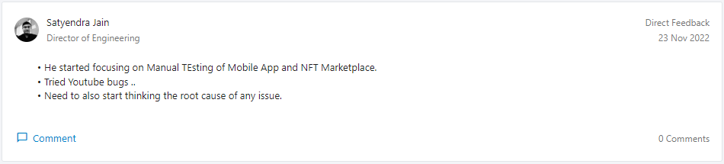
Feedback -

Slide 14
Mobile App Testing -
I did it on Android and iOS device both.
There are some bugs left like on android permission and QR scanning.
I tested Sign up, Log in, update, pay to consumer module and utility module.
Now, I also tested on dark mode settings.
Now, Display size setting is currently on work, finding issue from developer side.

Slide 15
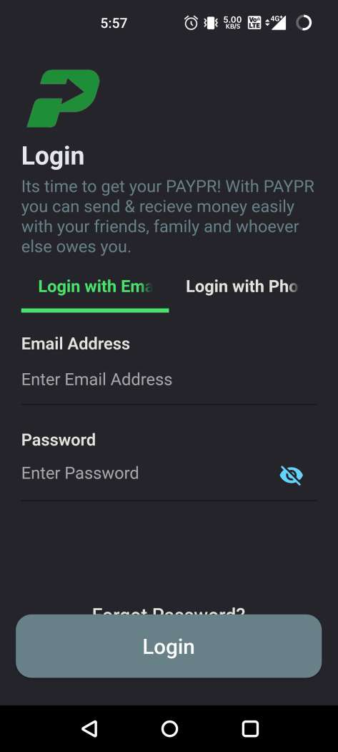
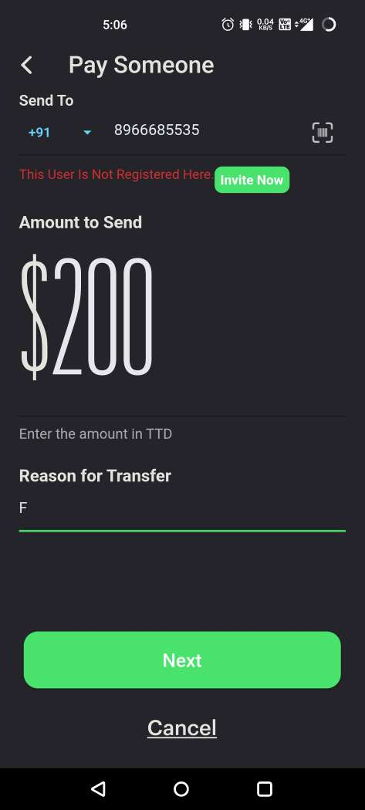
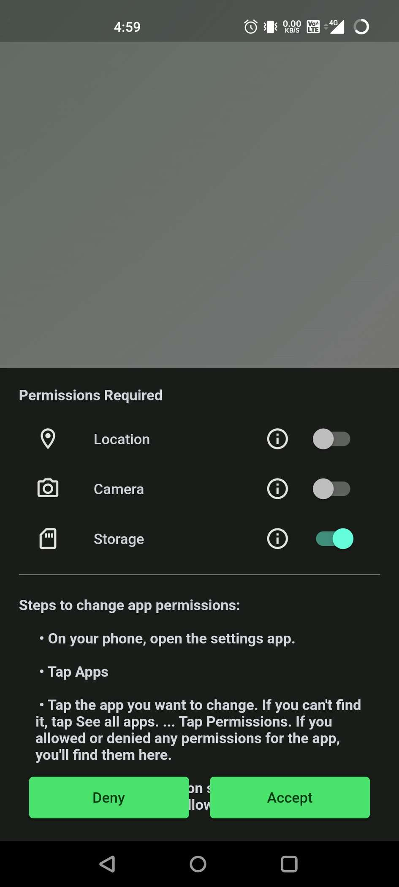
GLIMPSE-

Slide 16
Web Application Testing (UCM Backoffice)
I tested on Front-end.
I tested Users, Consumers, some of Payment and Communication modules.
I also check logs to check whether the issue coming from backend or from frontend or Nose.
Ex- today there was an error on ‘Search Consumer’ module, which was ‘Invalid JSON found’, then I checked logs, so it was coming from Node side.
There are some bugs left, like mobile no. field limit is hardcoded, search filter is not working properly and in P.C(1) screen username has ‘LIKE’ query, which is coming from ‘userSearch’ api.

Slide 17
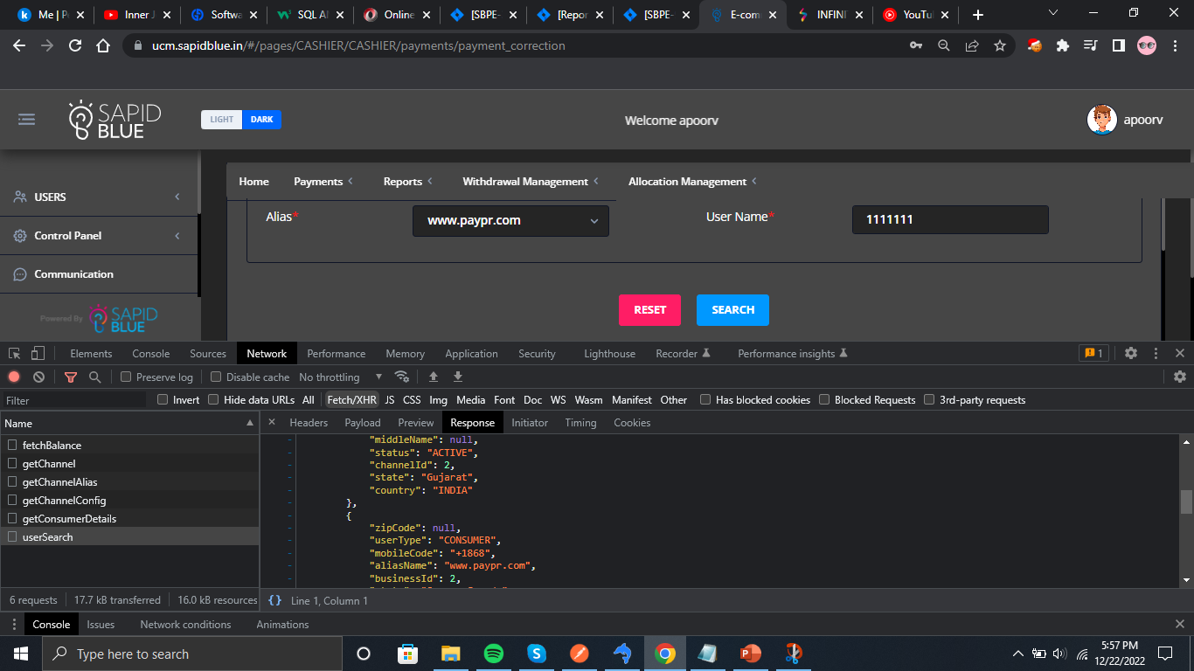
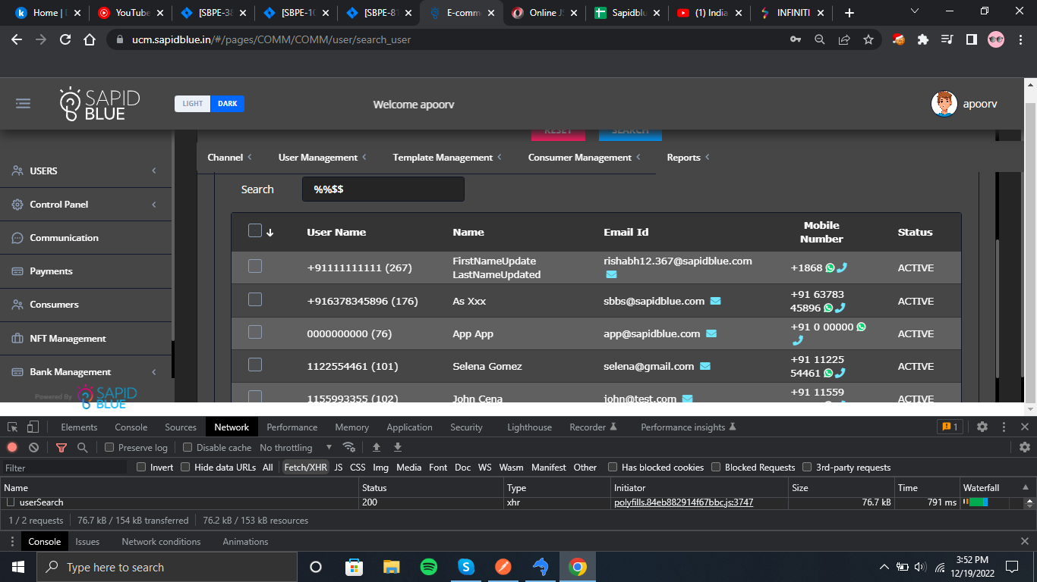
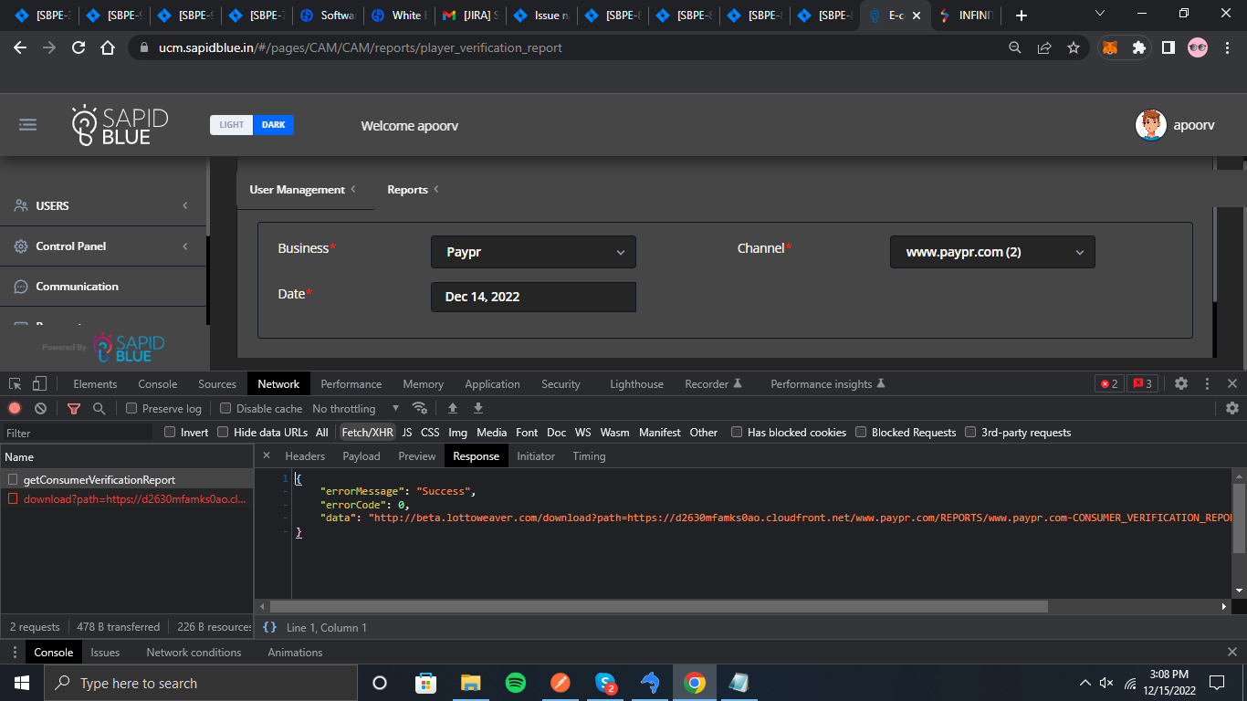

Slide 18
More Working……
Python Automation (BDD framework) [Self-Learning]
Katalon studio (mobile app, api and web-testing, database connectivity[for validation])
Postman capturing request for mobile app.

Slide 19
THANK YOU

Slide 20
Testing
Work Done till mid November
- Apoorv Gupta

Slide 21
Mobile App Testing
I have done functionality testing as well as UI testing also.
I did this on both Android and iOS device.
I have tested Sign up, Log in, update, pay to consumer module.
I checked error logs of that specific service, to know the error cause.

Slide 22
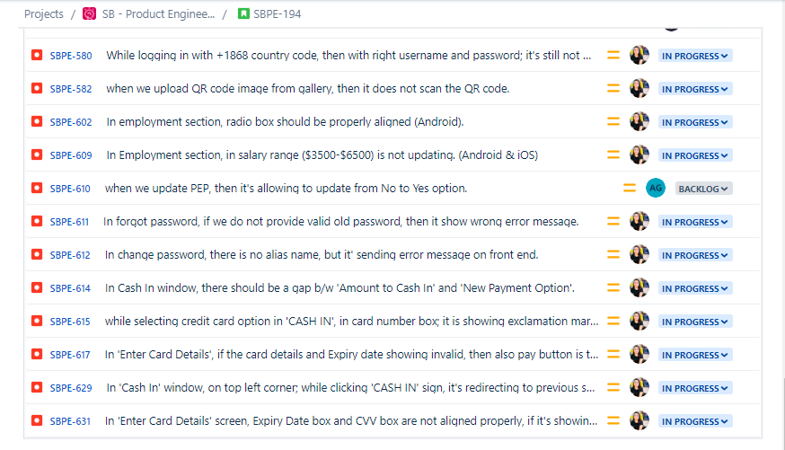
Consumer app bugs

Slide 23
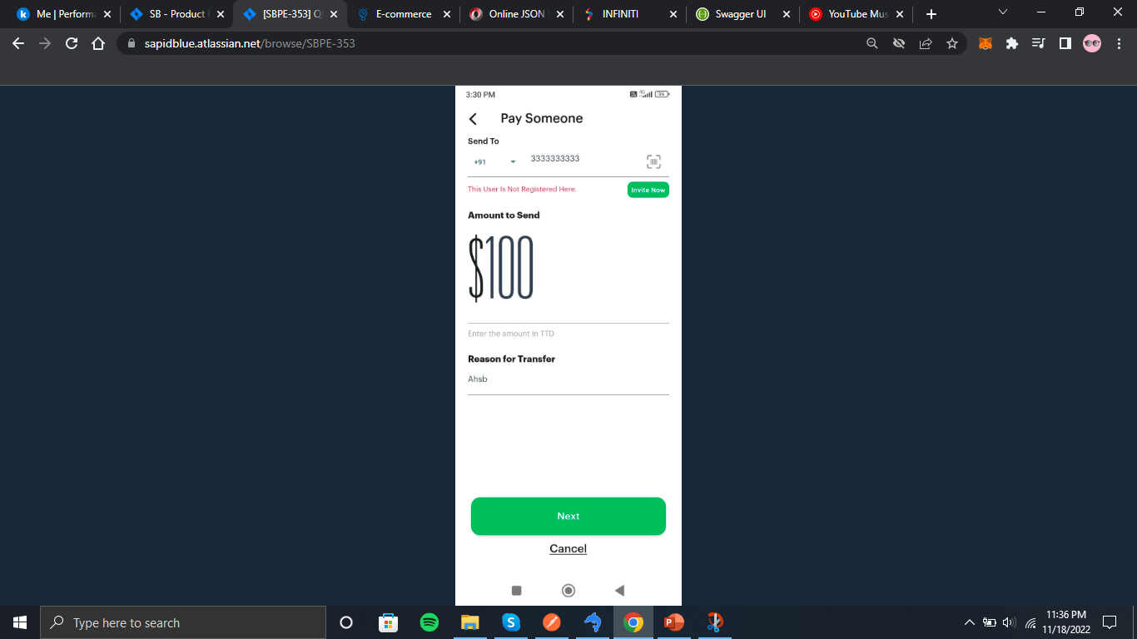
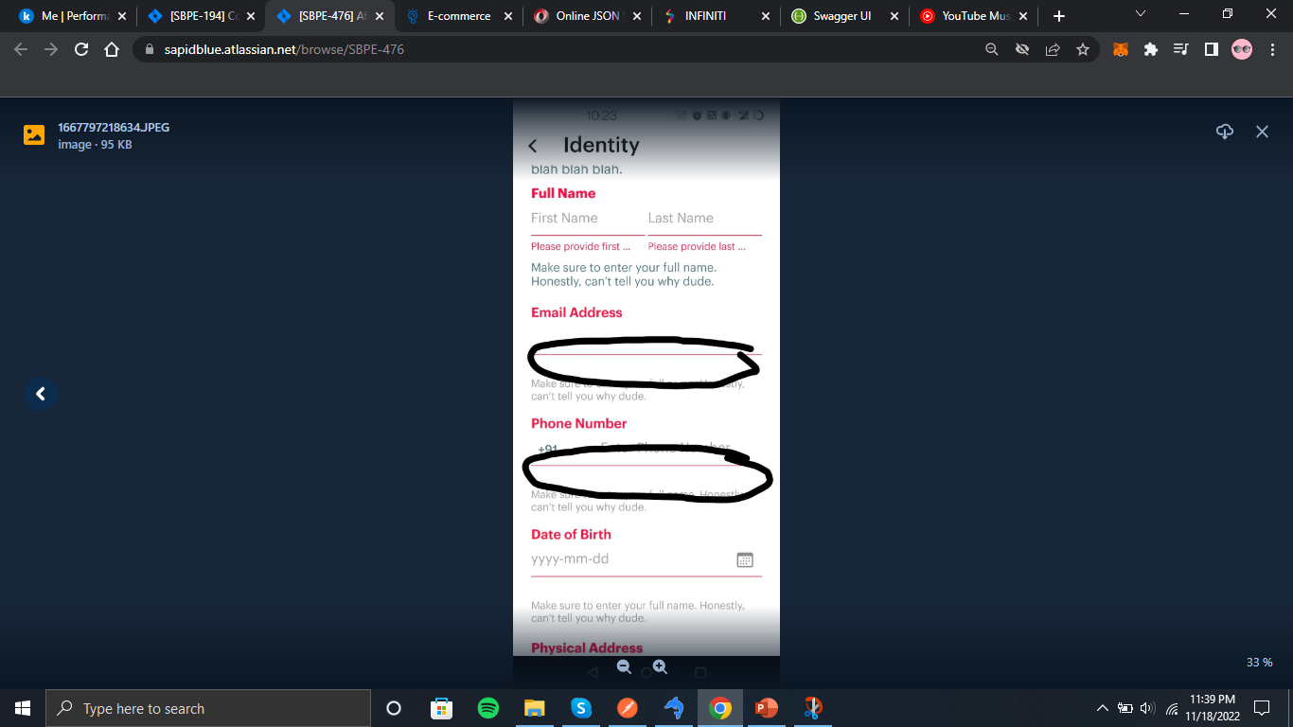
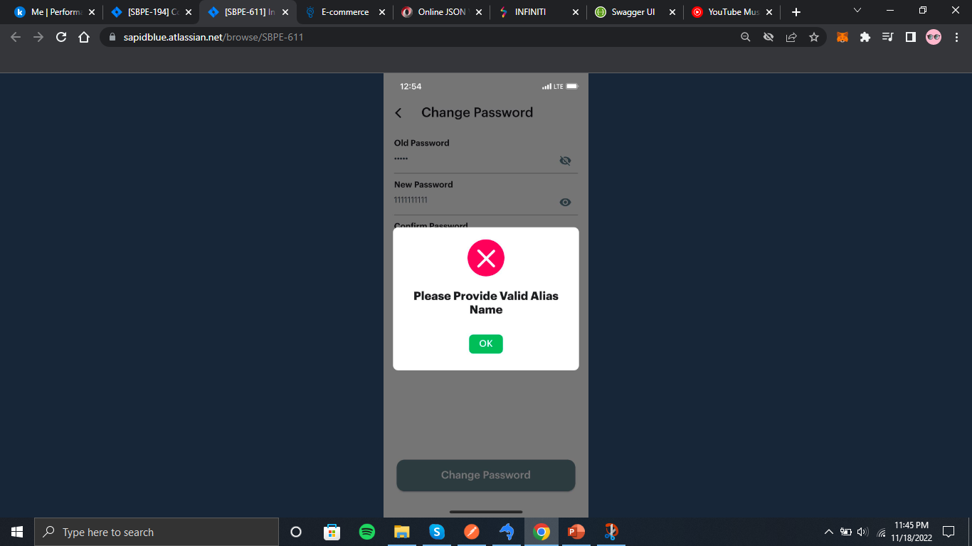
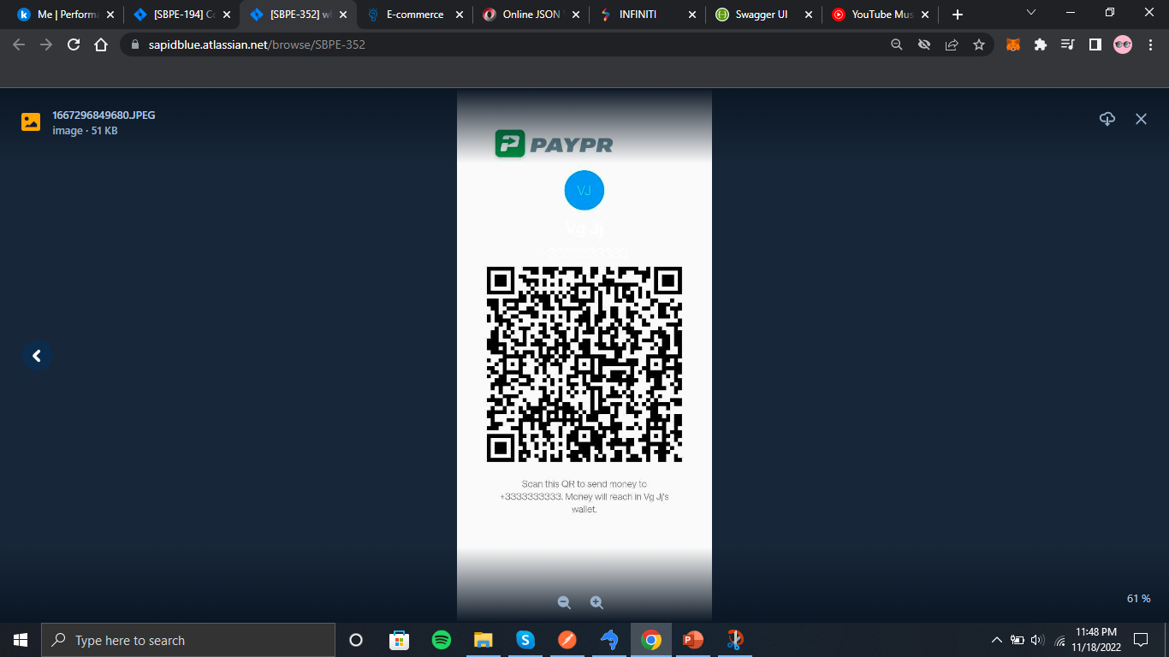
Leaving blank space, if we do not fill required fields
If invalid old password is given, then showing wrong error message
Sharing QR code, country code is
not displayed and name is also
not visible
QR scanner is not working

Slide 24
Web Application Testing (UCM Backoffice)
I have done api testing and UI testing too.
In this, I tested api in chrome console and network in inspect.
Also, I checked api response in error logs of that specific micro-service.
I have tested ‘Users Module’, in which there is Business, channel, alias and Users registration and Search menu options.
Also, In control panel, I have tested Create Role, Edit Role, Manage Configuration and Permission menu option.
Tested Consumer module → Search Consumer and Consumer Profile Update menu option.

Slide 25
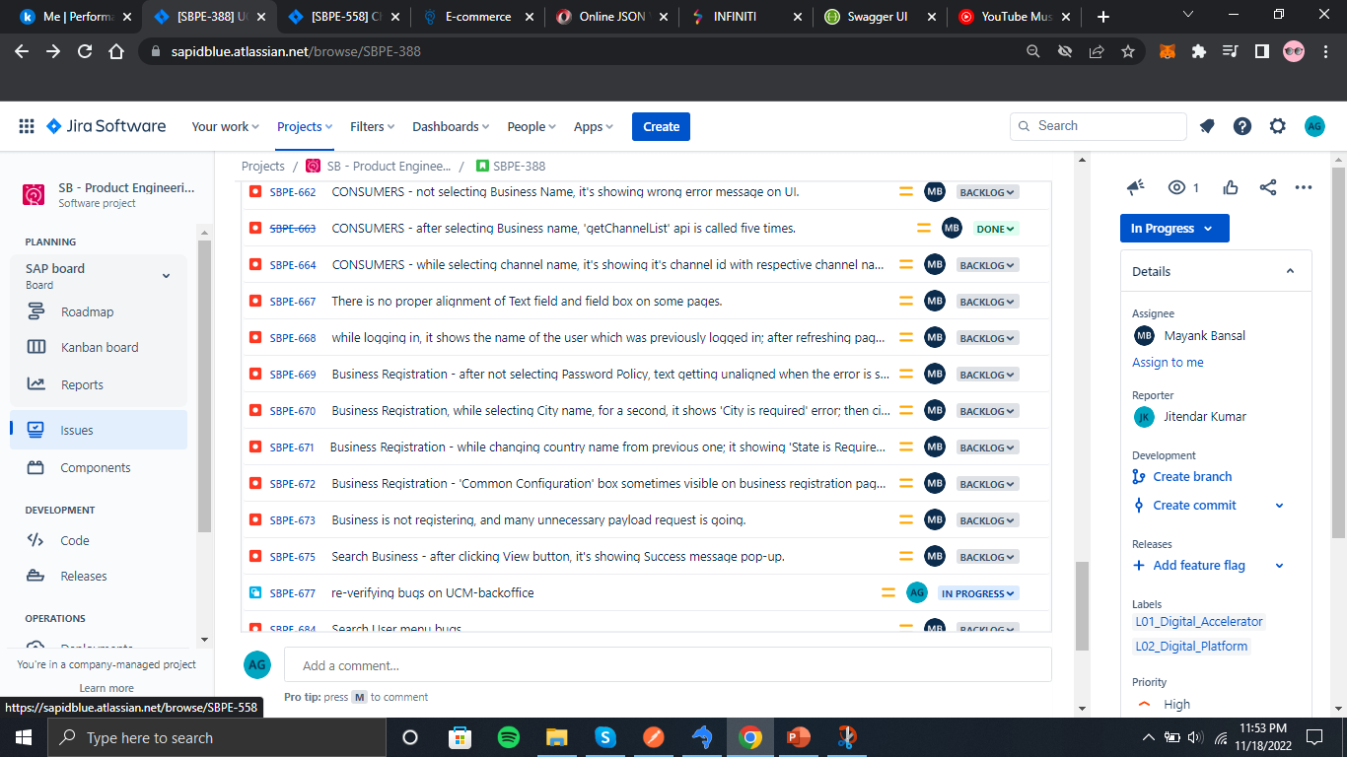
UCM Backoffice
UCM Bugs

Slide 26
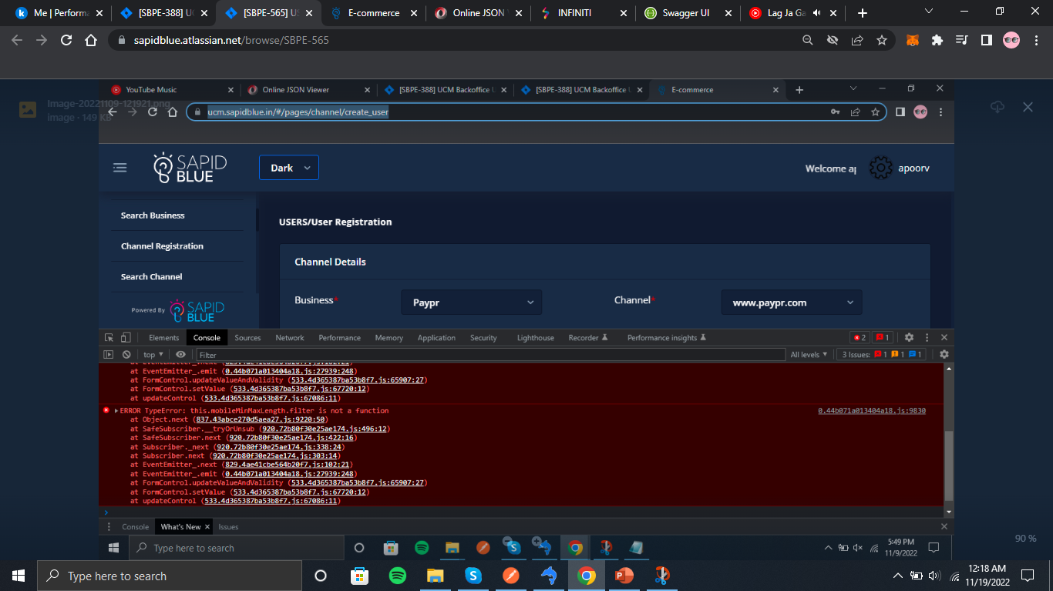
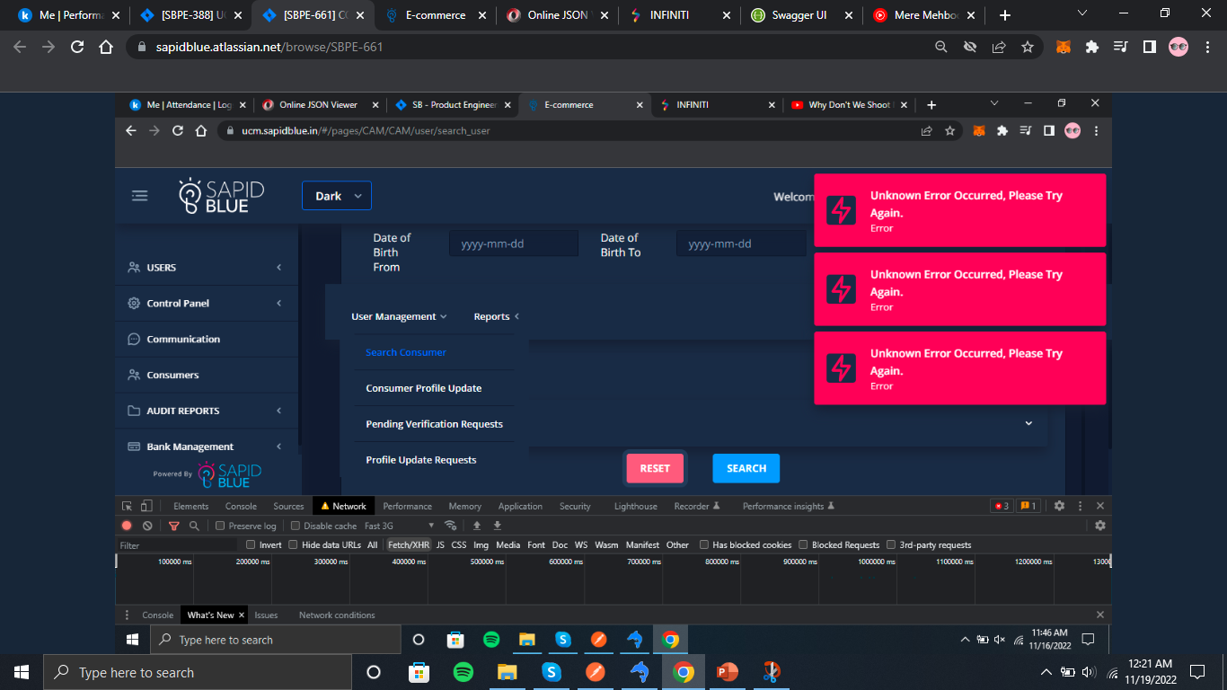
USER REGISTRATION - while selecting Business, it's giving error on console.
CONSUMERS - after clicking Reset button, it's showing ‘Unknown Error Occurred' multiple times.

Slide 27
NFT Marketplace web testing
In this, I first get K.T. of this project and what is the flow of it.
Then, I did exploratory testing of web application.
I did basic functionality testing, also some of UI part.
I also did performance testing of some api on JMeter.
I have to test Page load testing of NFT marketplace.

Slide 28
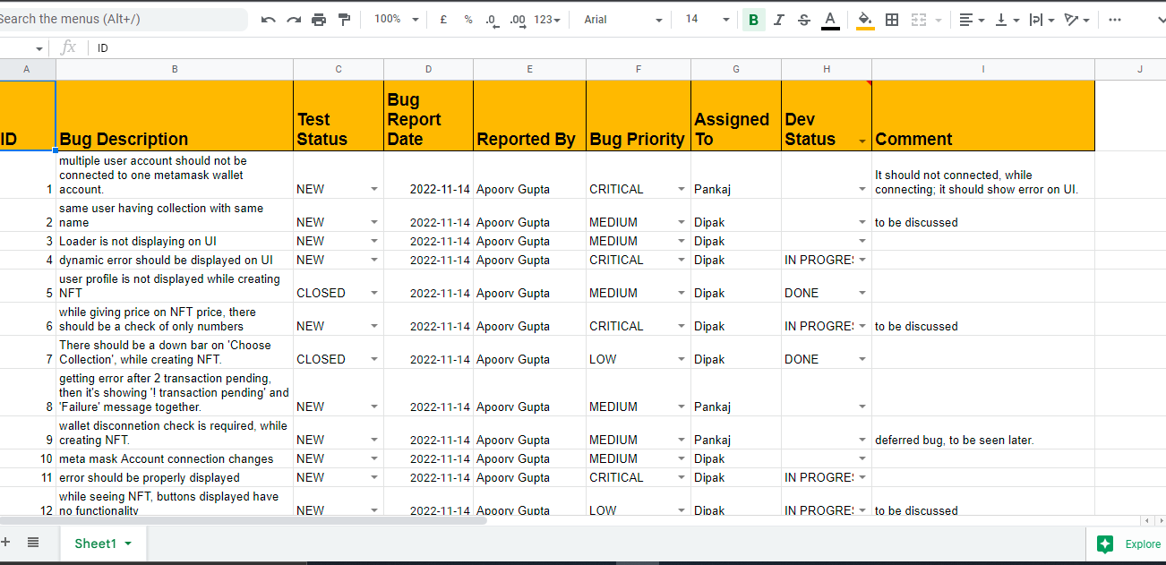
NFT Marketplace bug Report
NFT Company

Slide 29
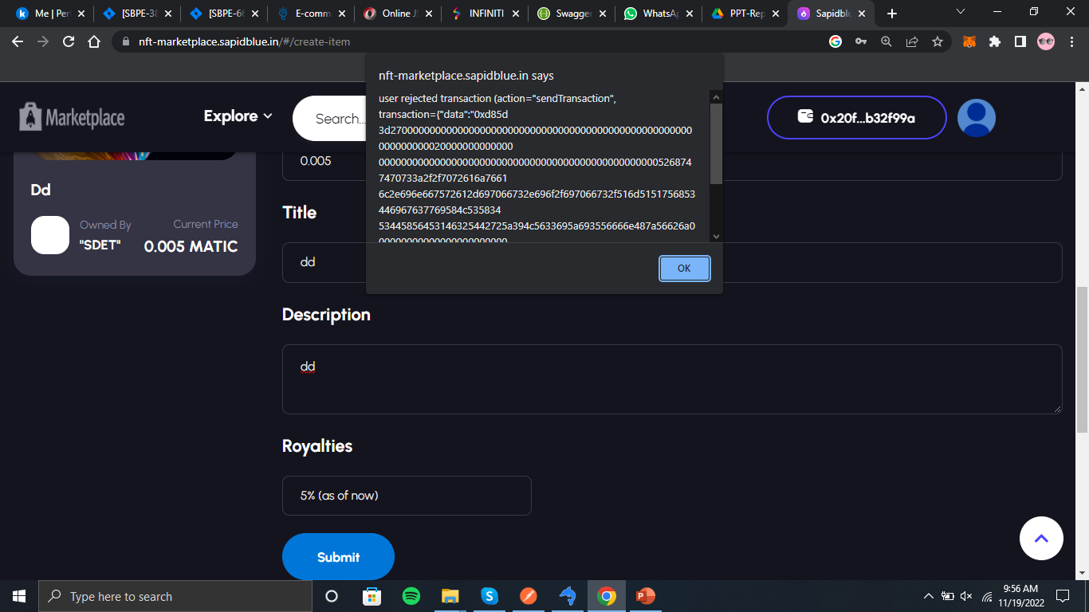
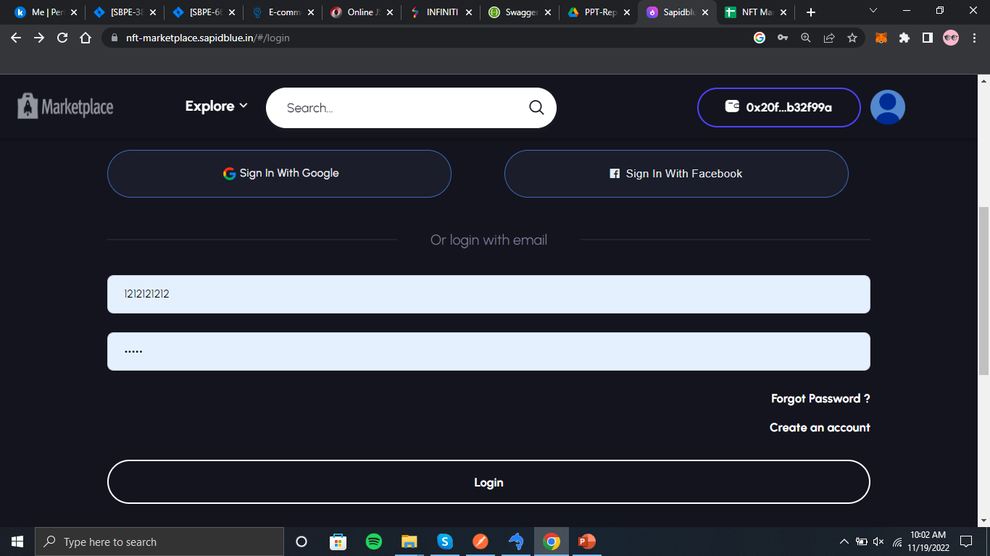
If we reject meta mask transaction, then it’s showing this error
after logging in, when we get back to previous page, it redirects sign in page and username and password can be shown.

Slide 30
THANK YOU

Slide 31
JMeter and ELK Stack
Work Done till mid October
- Apoorv Gupta

Slide 32
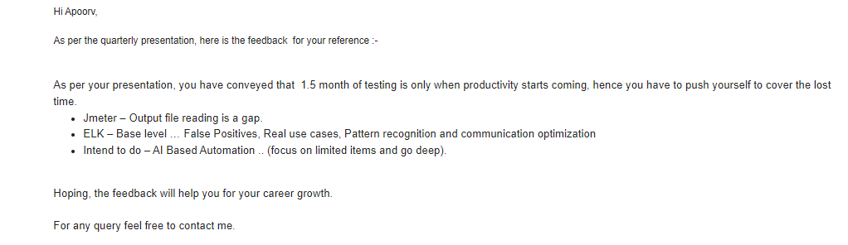
Feedback

Slide 33
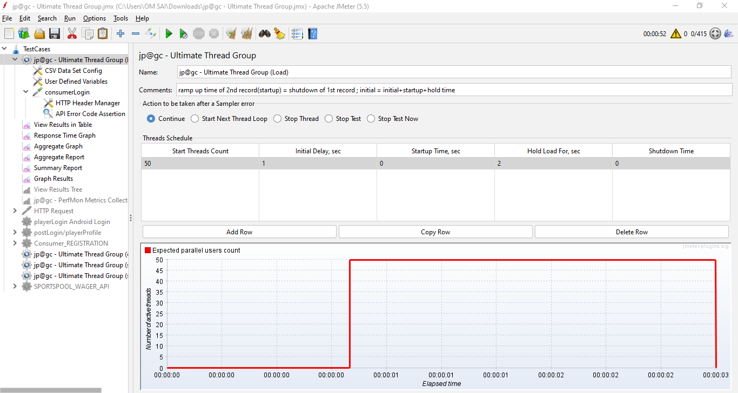
JMeter
Learning of Non-Functional Testing methods. We use ‘Ultimate Threading’.
Load Testing

Slide 34
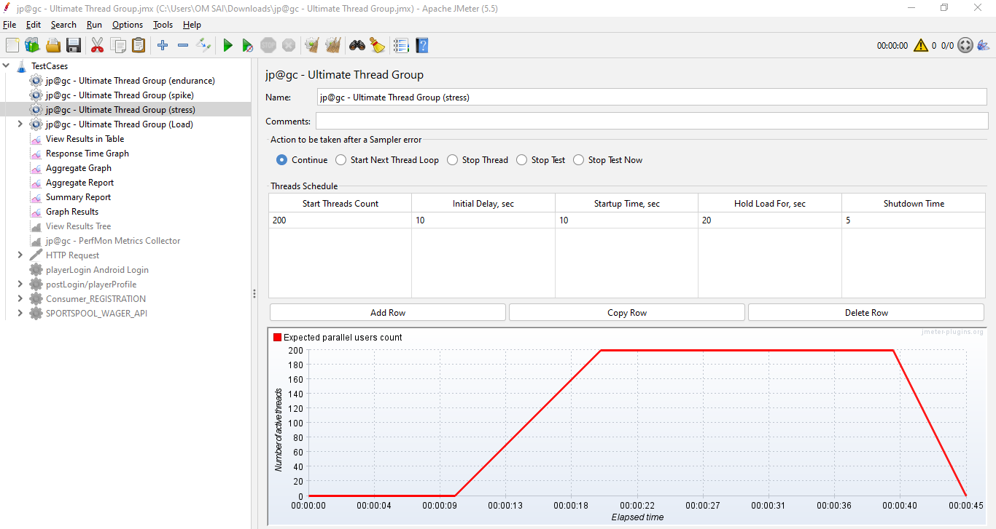
Stress Testing

Slide 35
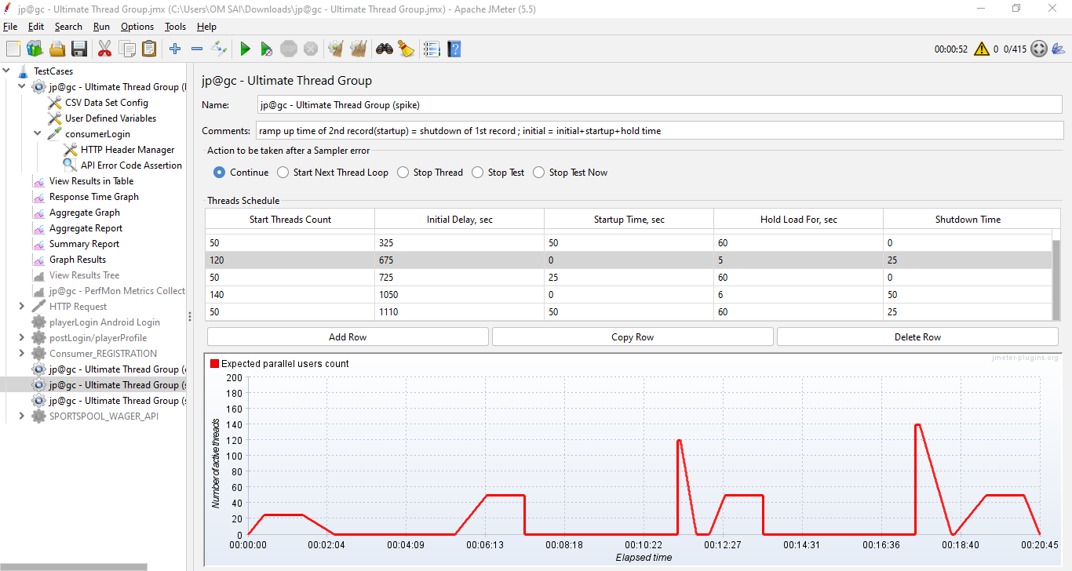
Spike Testing

Slide 36
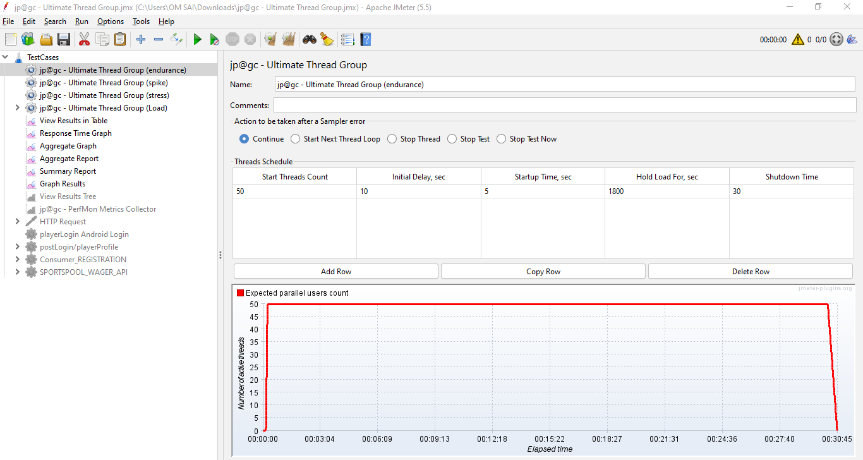
Endurance Testing

Slide 37
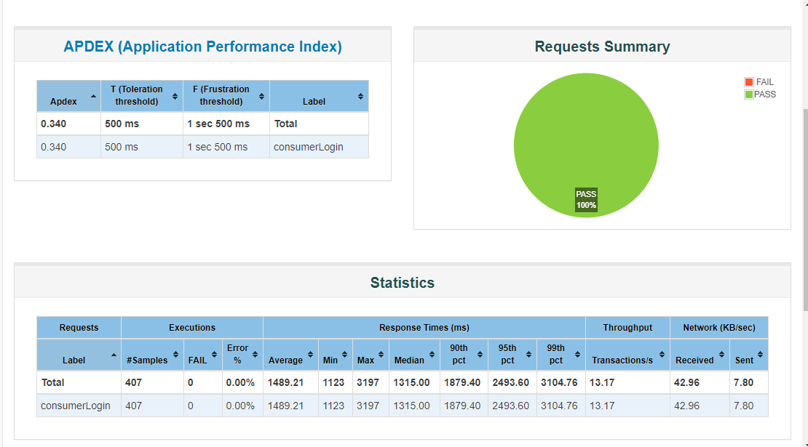
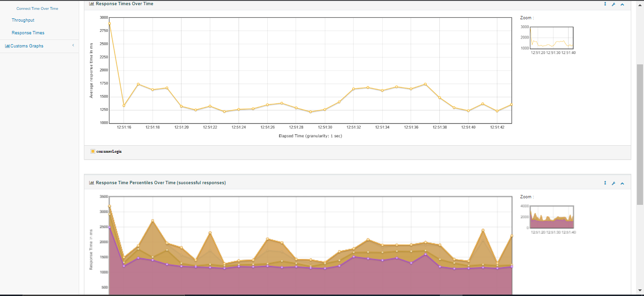
HTML Reports

Slide 38
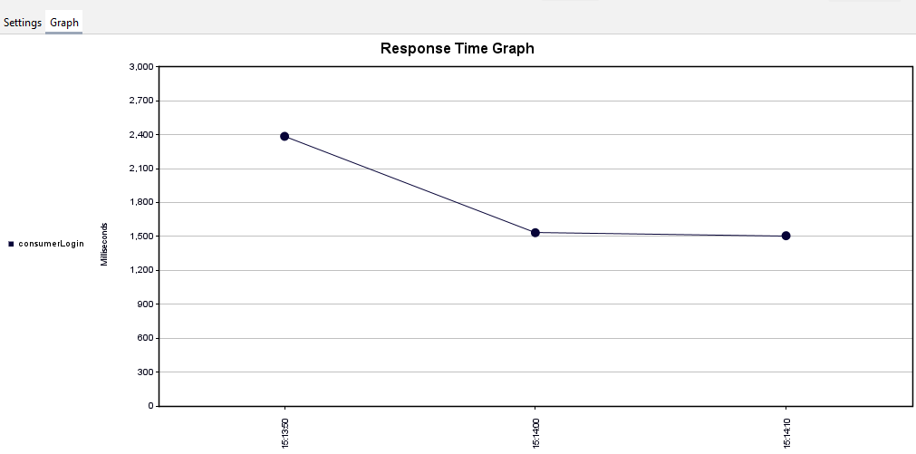
Summary Report

Slide 39
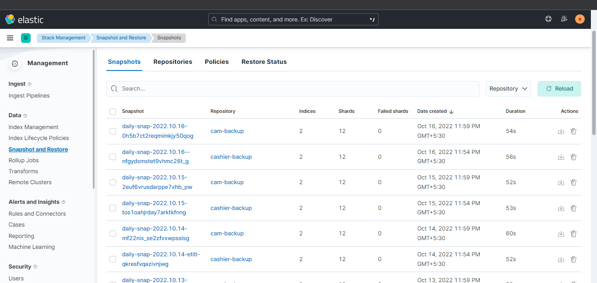
Snapshot and Backup Management

Slide 40
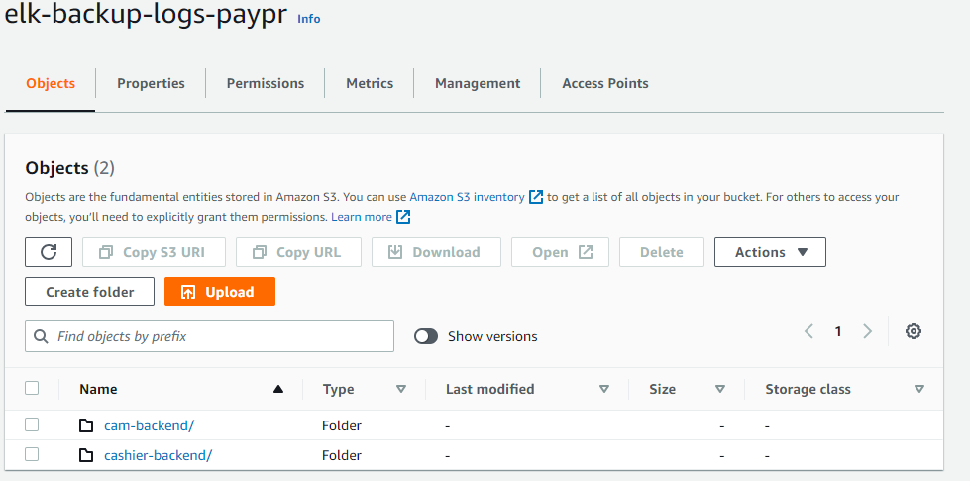

Slide 41
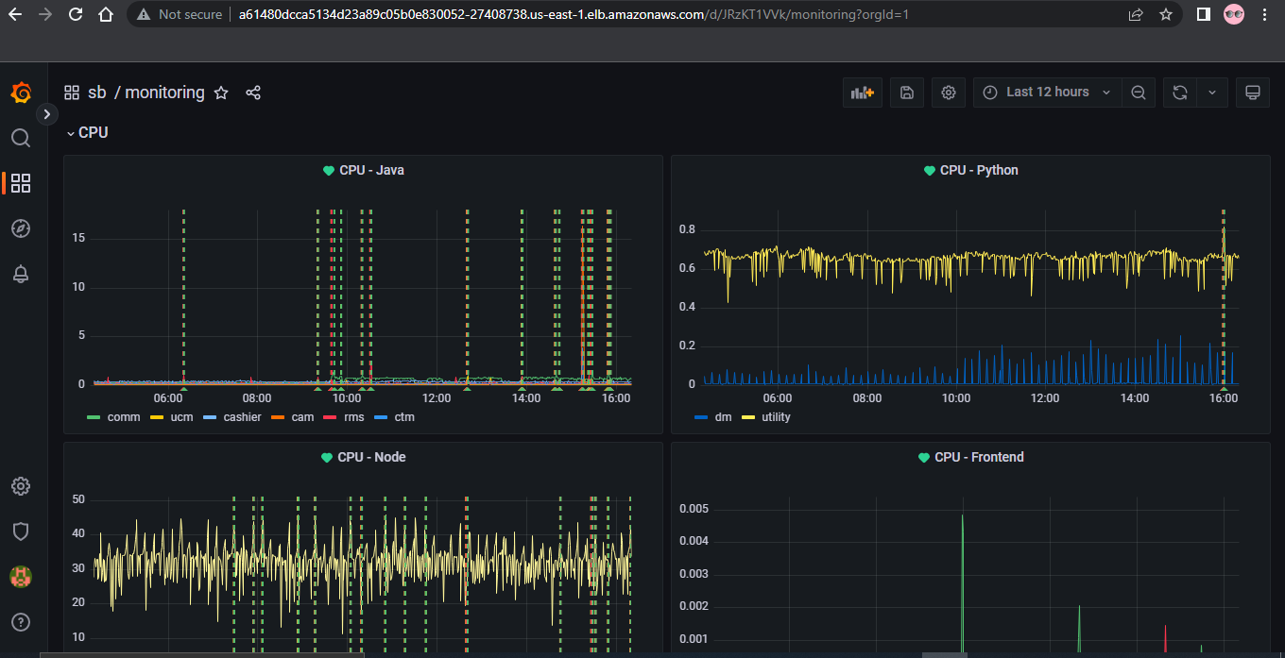
ELK ML -
ELK ML PPT
More Work -
Grafana Dashboard and creating alerts to Slack.
Exploring ELK.

Slide 42
Creating Shell script for shooting mail to Slack, if there is no registration since 1hour or specified time.
Creating Shell script for deleting logs on server.
Creating Cronjob.

Slide 43
THANK YOU

Slide 44
JMeter and ELK Stack
- Apoorv Gupta

Slide 45
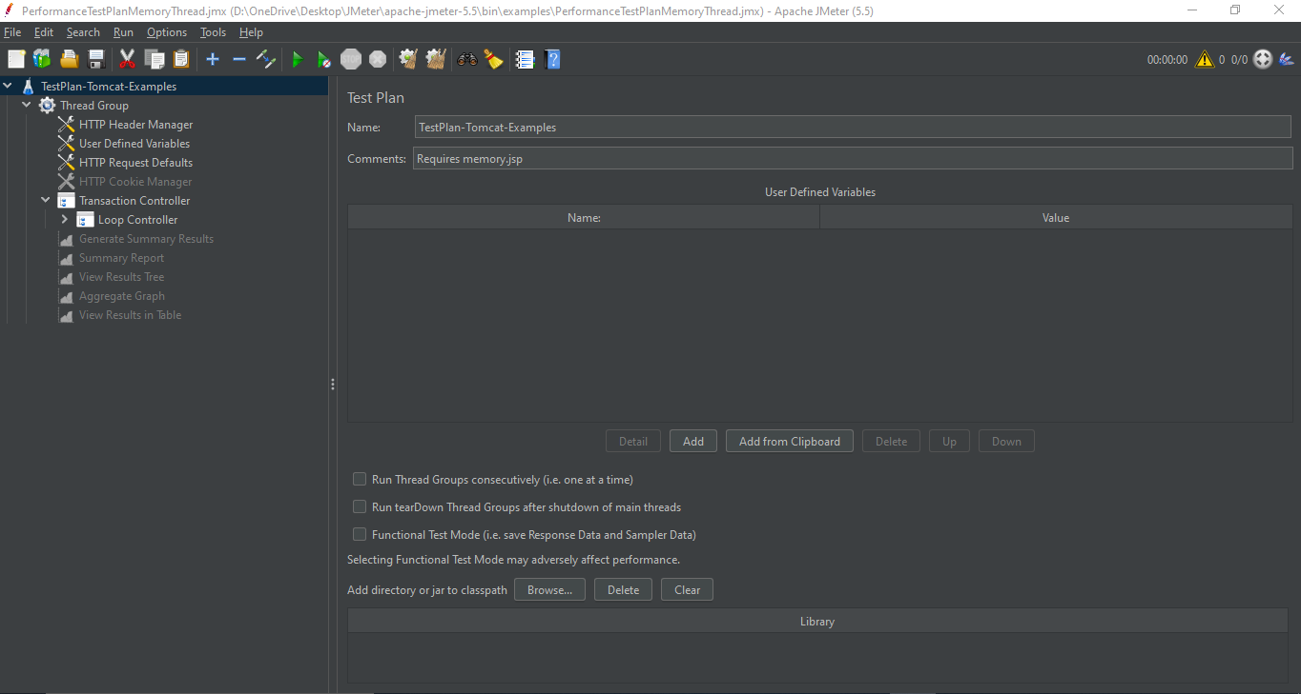
JMeter
It a load testing tool for analyzing and measuring the performance of a variety of services

Slide 46
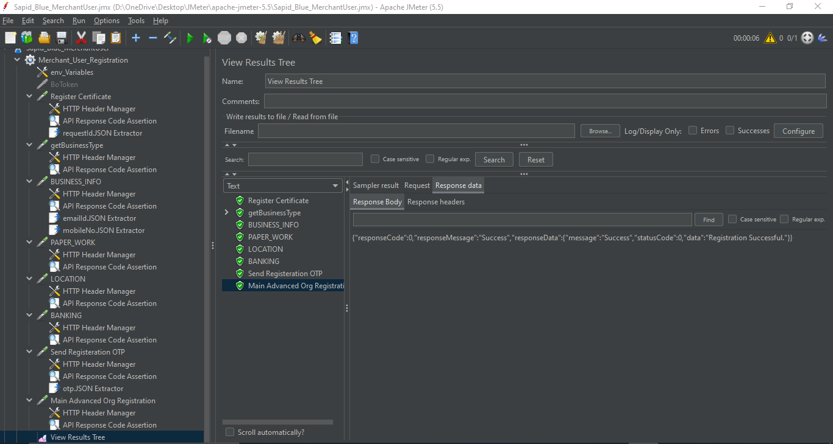

Slide 47
How This Works?

Slide 48

ELK Stack

Slide 49

Elasticsearch

Slide 50

Kibana

Slide 51


Slide 52
How This Works?

Slide 53
More Working……
1 AI Automation – request getting from different user, will help for better testing practices and also to store their data and use it for more user-personalized experience.
2 Gattling Tool – An open-source load- and performance-testing framework based on Scala.
3 Kibana -- Registration(Merchant, Consumer), Transaction and many more….

Slide 54
THANK YOU

